Slide 1
Fostering Empathy for Latin American Migrants through Game Design

Slide 2
Over the next two years, we will explore a convergence of scholarship & design.

Slide 3
Design Thinking and Game Design
are both Iterative Processes.

Slide 4
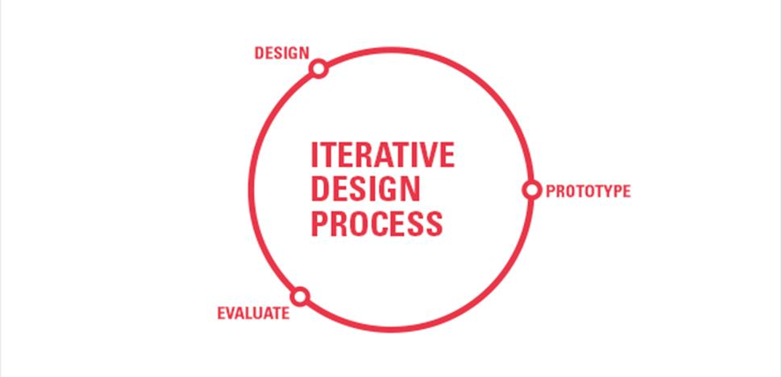

Slide 5
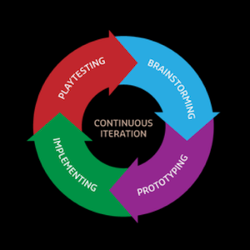

Slide 6
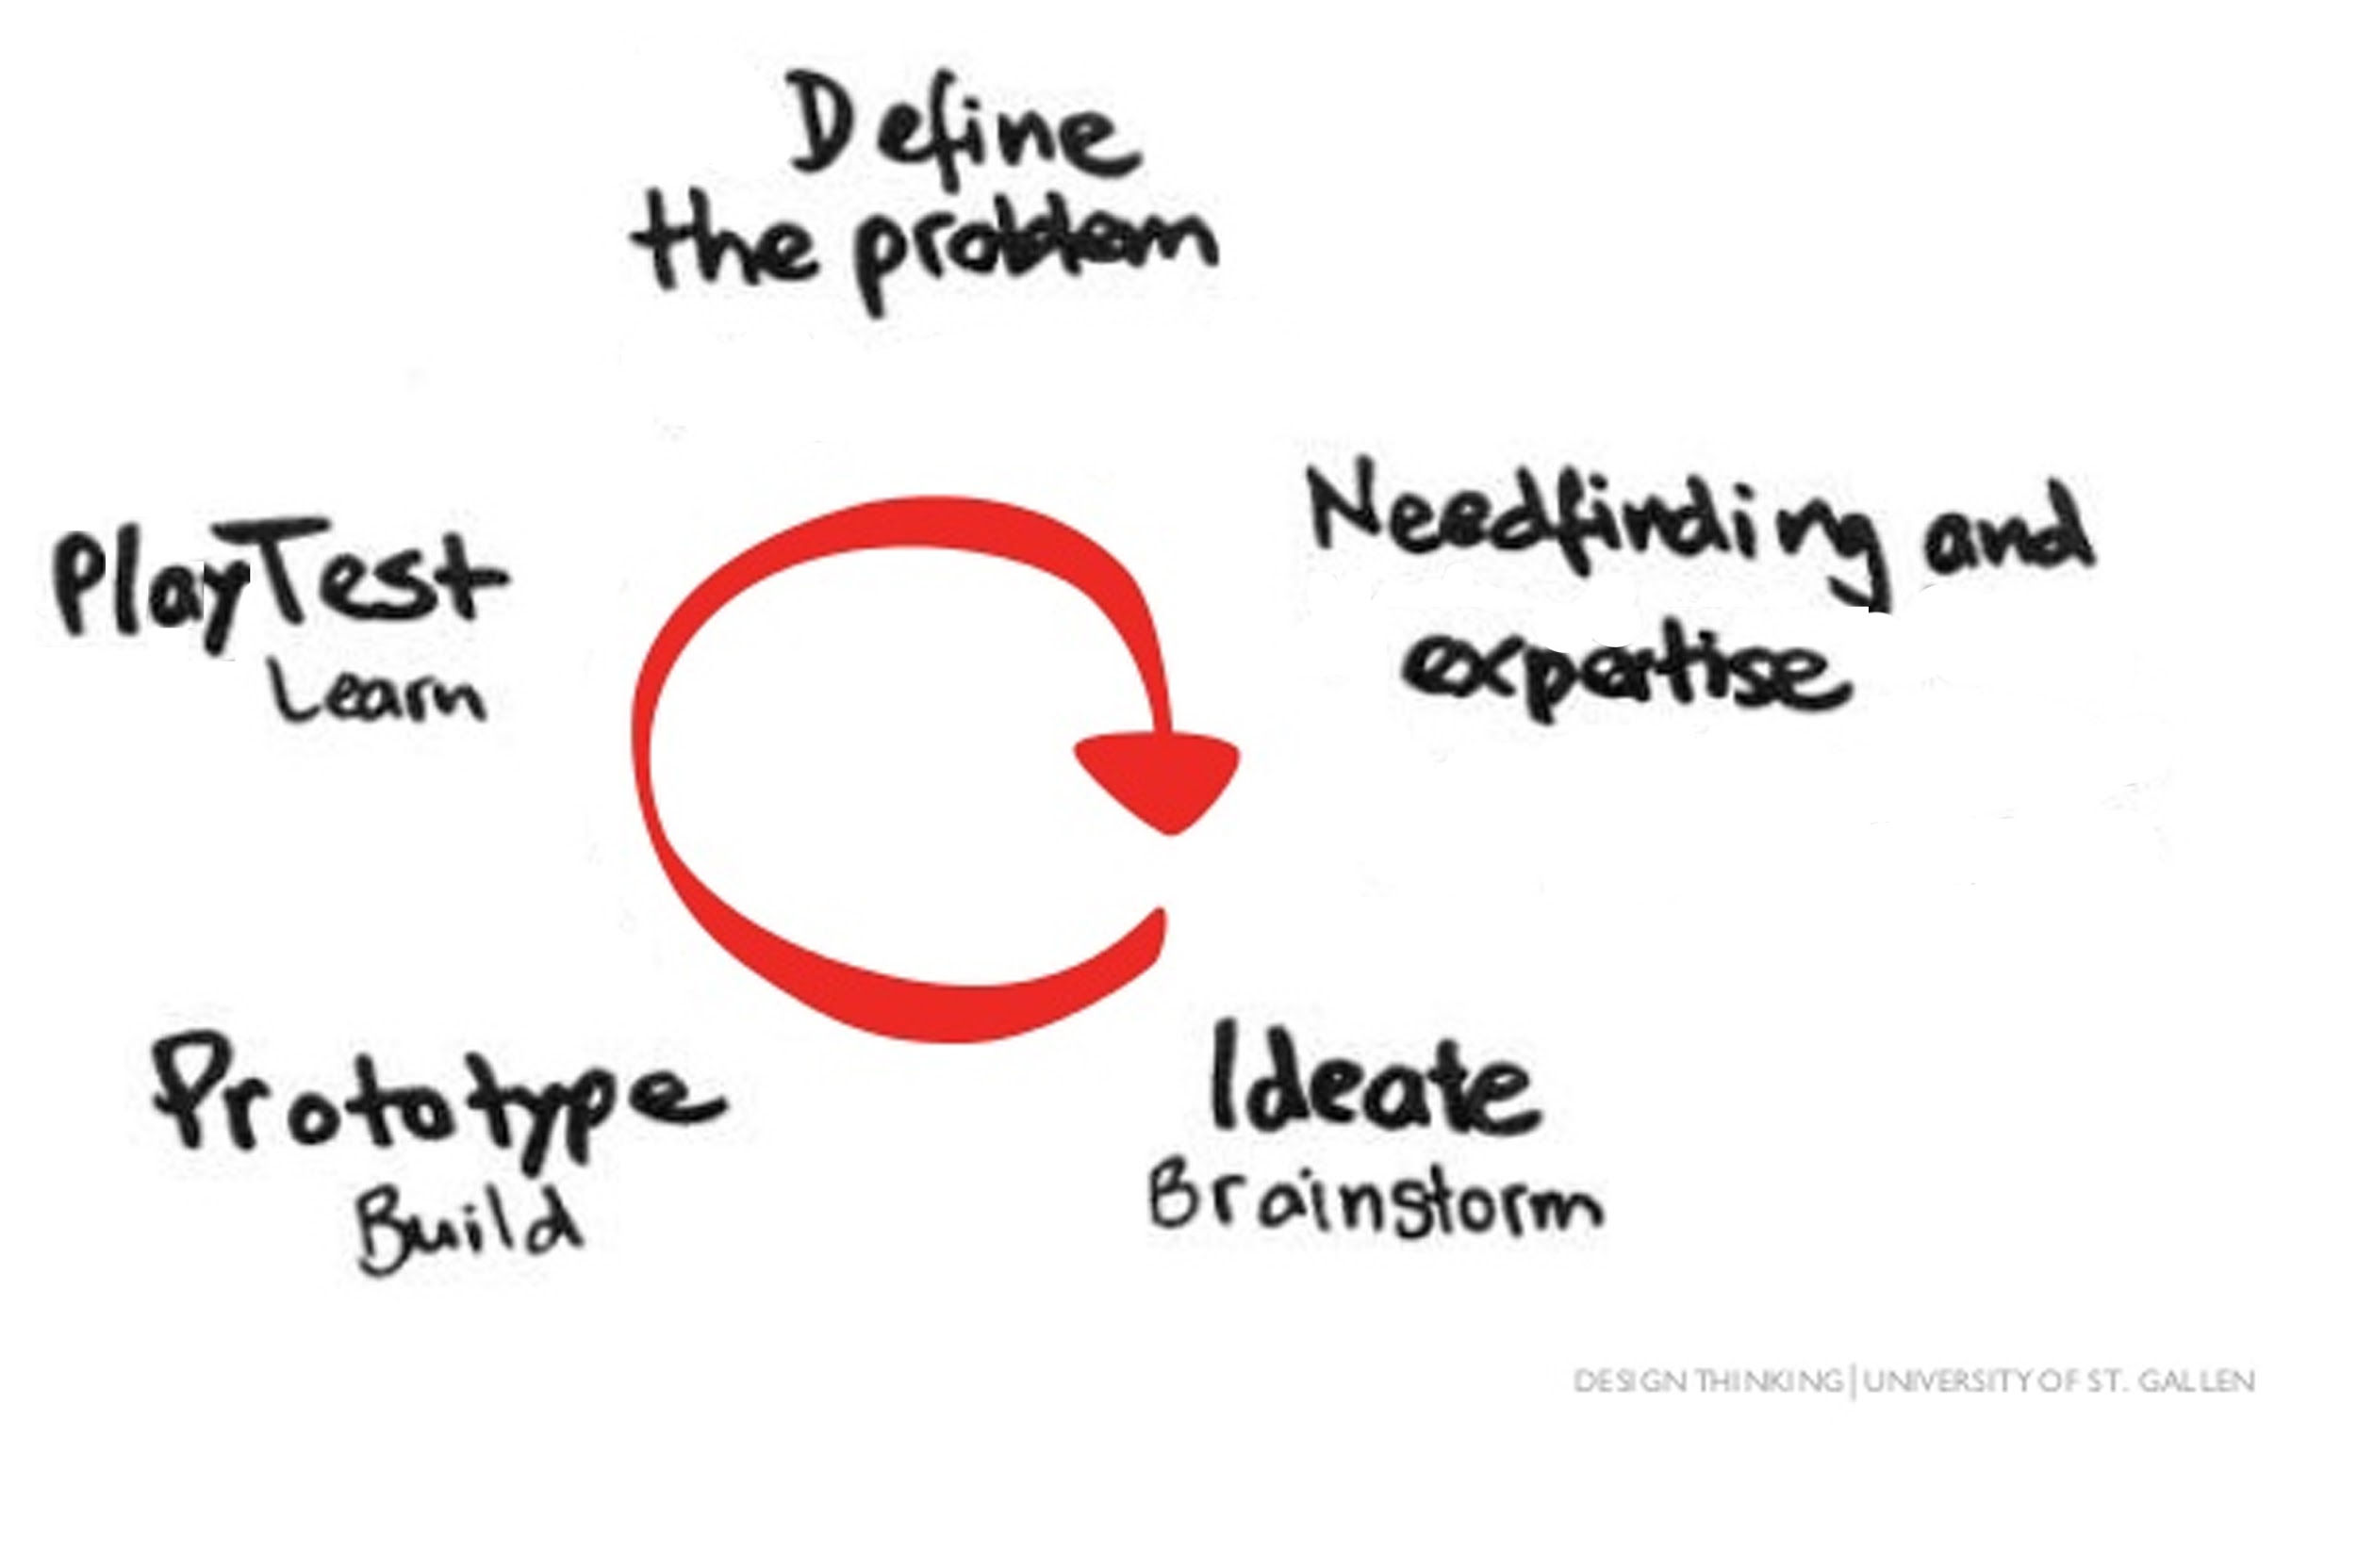

Slide 7
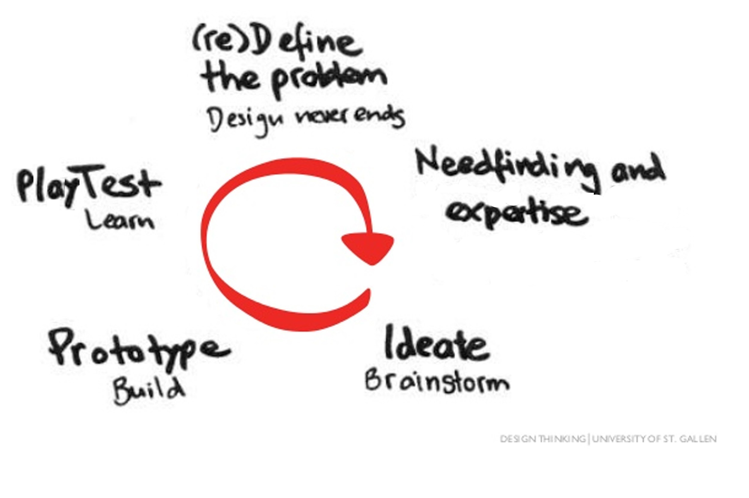

Slide 8
It’s perfectly okay if you don’t know anything about games or game design.

Slide 9
But What if you don’t even Actually like to play games?

Slide 10
That’s okay too! It might help to think about your work being translated, first, into a more familiar media.

Slide 12
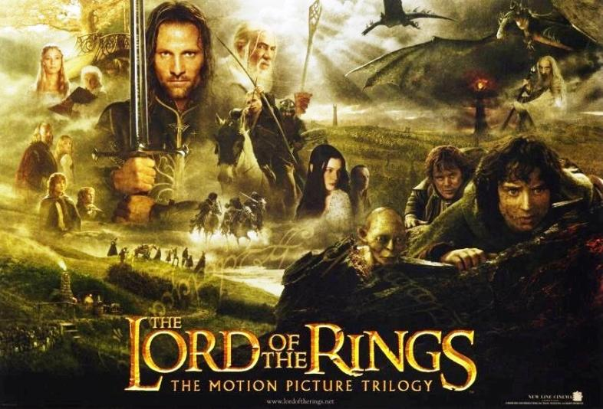

Slide 13
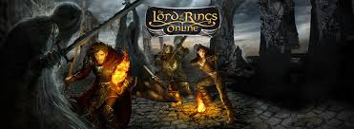

Slide 14
What’s different about the game
from the other two, is that it gives
the player choices.

Slide 15
Immersion can happen in a novel or film, but for choice
and interactivity, you need something more gamelike.

Slide 16
BBC’s The Syrian Adventure:
Choose your Own Escape Route

Slide 17
Bury Me, My Love

Slide 18
What do game designers mean
by empathy?

Slide 19
Empathy & Games
Christopher Ball, PhD / Department of Journalism

Slide 20
Overview
Part 1 – Empathy
Part 2 – Design
Part 3 – Measurement
Part 4 – Industry Example

Slide 21
Cognitive Empathy
Empathy in social sciences generally falls into two categories
1) Cognitive Empathy – Intentionally taking another’s point of view

Slide 22
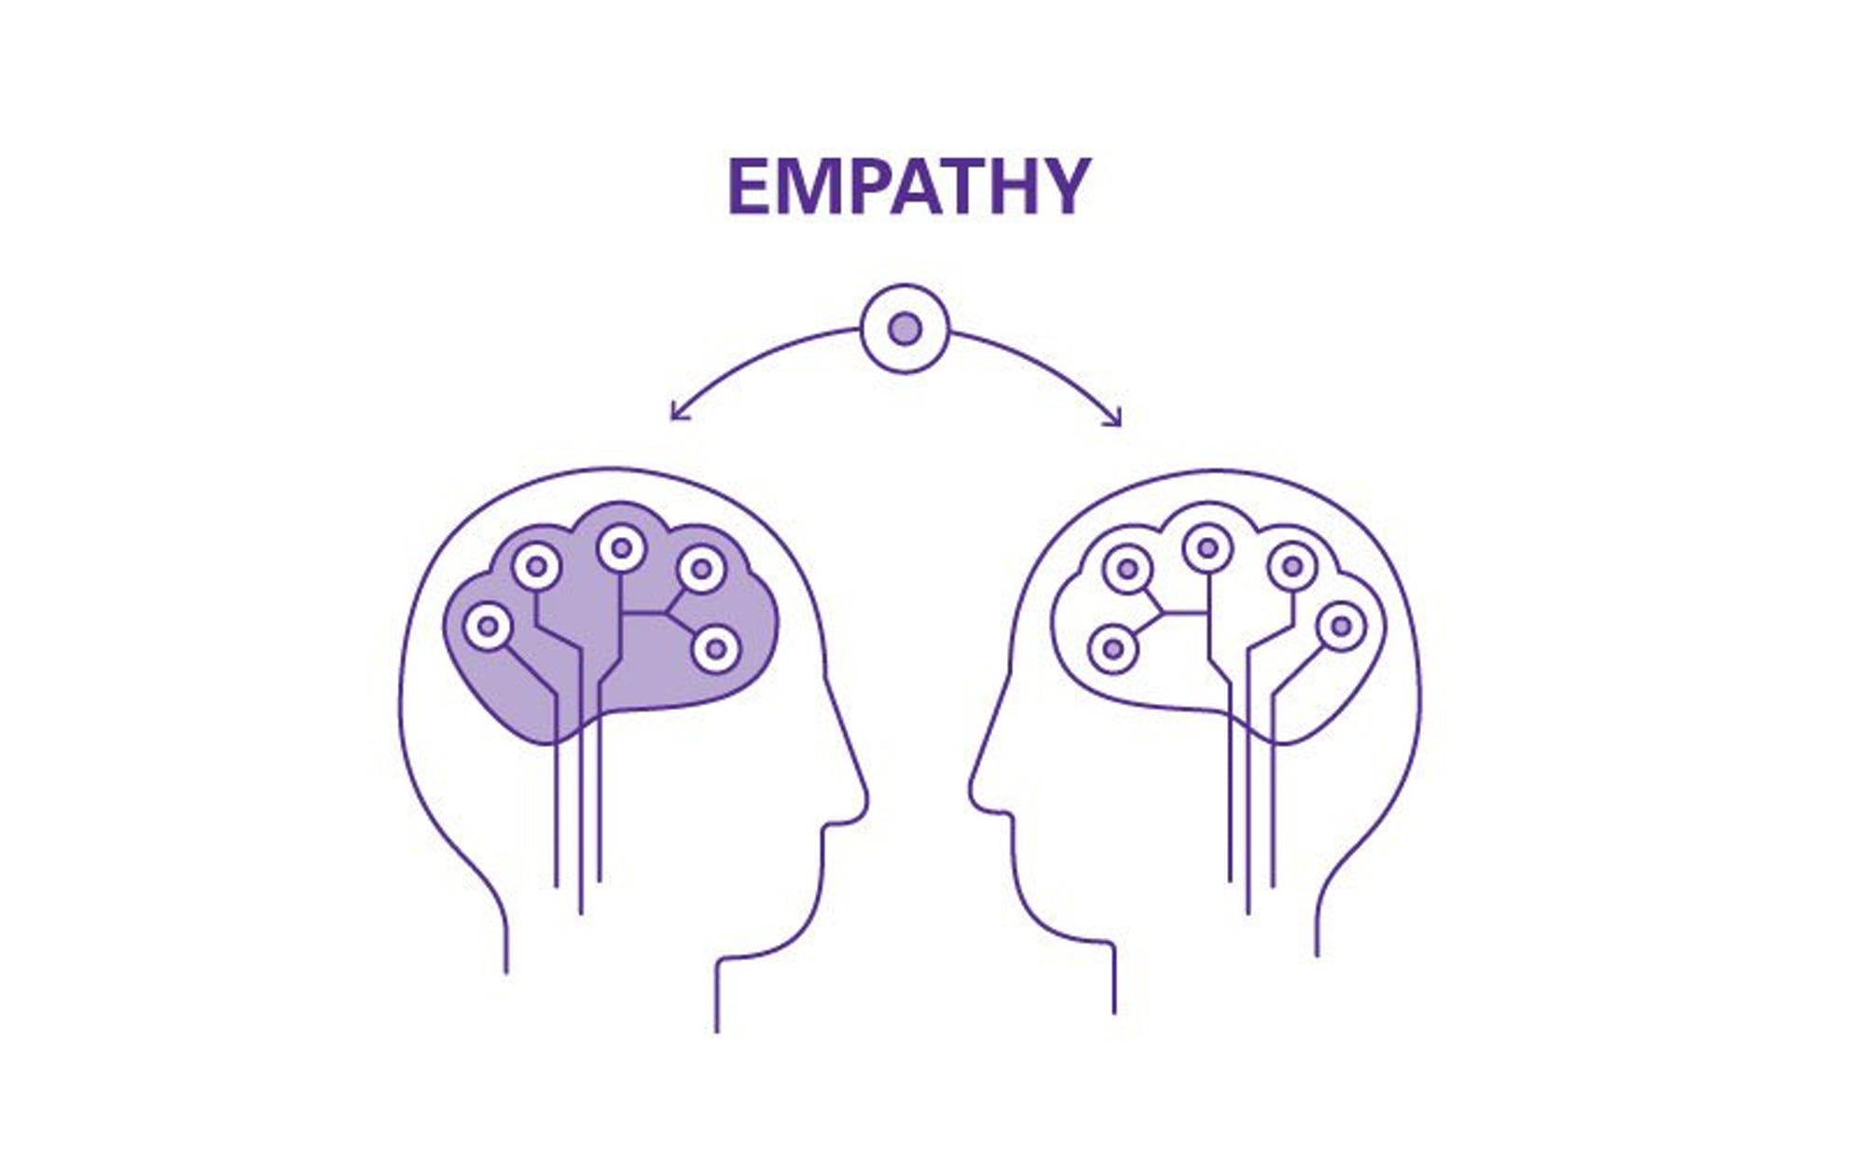
Emotional Empathy
2) Emotional Empathy
Parallel – Vicarious experience of another’s emotional state
Reactive – Emotional response that is different from another’s emotions

Slide 23
Why Empathy?
Empathy improves attitudes and behaviors towards individuals or groups
Reduce prejudice
Applied in many fields
Conflict resolution, counseling psychology, social work, education, etc.

Slide 24
Why Empathy Games?
Games are well-suited to foster empathy
Inhabit the roles of others in an immersive way
See issues from different perspective

Slide 25
Empathy Design Principles
Principle 1 – Empathy Induction
Players are likely to empathize only when they make an intentional effort to do so as the game begins
Principle 2 – Empathy in Action
Give players possible actions that can address the issues in the game
Principle 3 – Empathy Combo
Emotional empathy works for small changes, but needs to be paired with cognitive empathy for bigger changes
Principle 4 – Emphasize Similarities
Emphasize points of similarity between players and people, but beware of provoking defenses

Slide 26
Measurement
Established Scales
Ethnocultural empathy (Wang et al. 2003)
Create Custom Scale
Measure Behavior
Donations, petitions, volunteering, paper writing, etc.

Slide 27
Industry Example
Hellblade – Very successful AAA game that tackled serious subject matter (i.e., mental illness)
Sought to increase empathetic understanding
We analyzed the design decisions that contributed to its success

Slide 28
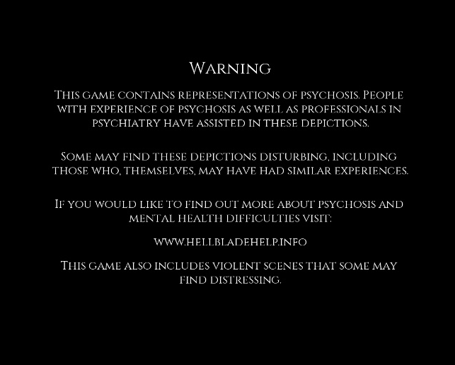
Industry Example
Transparency
Dev diaries
Intro screen
Input
Mental health professionals
Scientists
Patients as advisors
Accuracy
Acting
Binaural sound

Slide 29
Did it work?
“I had a psychotic break several years ago, my brother never understood. I overheard him say he was ashamed of me. After this game, he turned to me and said he was sorry. You got a message across that I never could.”
“With Hellblade, I can understand my father now and can talk to him about his pain. Now I feel able to help him. You have changed my life. Thank you from my heart.”

Slide 30
To make well-designed games, we have to understand what
makes a bad one.

Slide 31
Rubbish Migration Games
How to make your game not garbage.

Slide 32
Here are 4 examples to illustrate this
Just because your goal is noble...
...doesn’t mean your outcome will be praiseworthy.
Notes:
If you want people to play your game, it needs to be a good game. Generally, people don’t often excuse games or even some other forms of entertainment just because someone set out to do something good. But people will watch or play games with a “bad” message if it’s fun and the parts work together. There’s a reason people play Grand Theft Auto.

Slide 33
Aesthetics
Darfur is Dying
Narrative
Cloud Chasers
Medium
Fun
Against All Odds
Notes:
I’m going to show 1 game that fails at these elements, talk about why it fails and then a game, migration or not, that does it well and why. You may even find games that lack attention to one of these elements, but generally, the others are strong enough to make it viable.
Also, I’ve used the term medium, because I am trying not to make this computer game specific. [Could apply to board, card, tabletop, and physical games]

Slide 34
Aesthetics

Slide 35
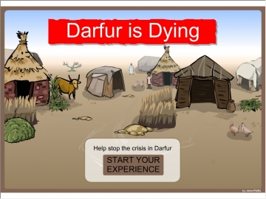
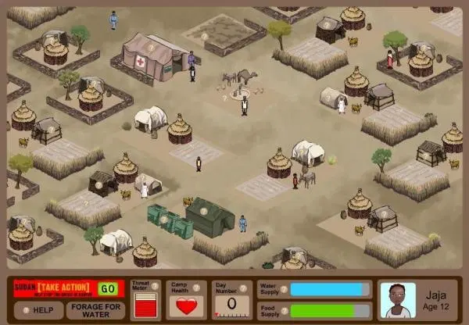
Darfur is Dying
Notes:
Beige MS Paint

Slide 36
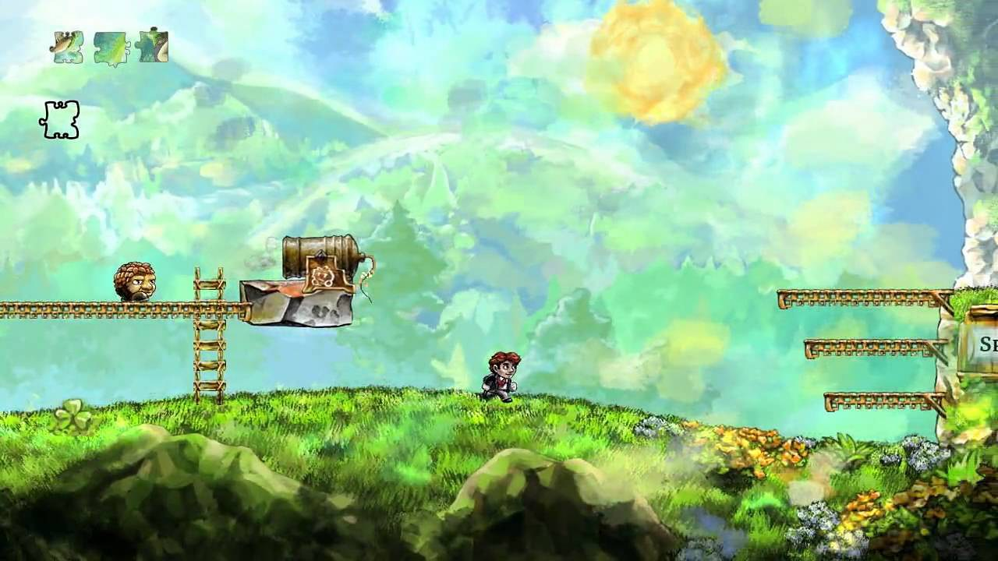
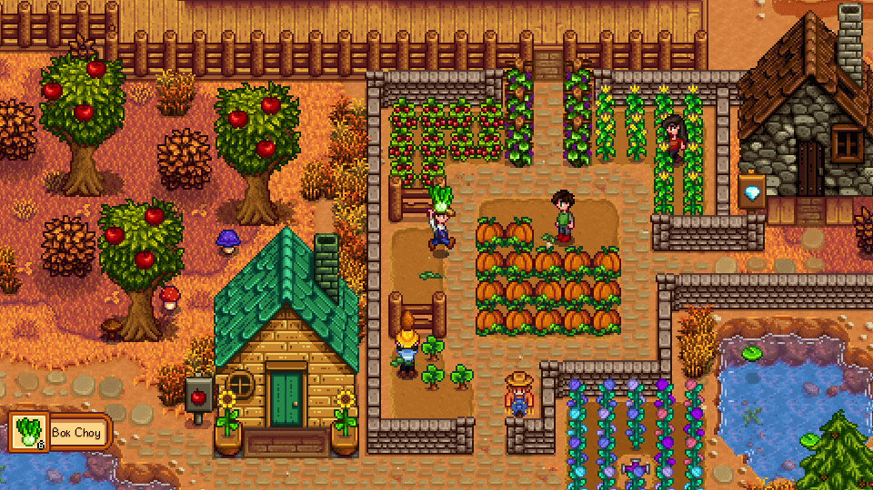
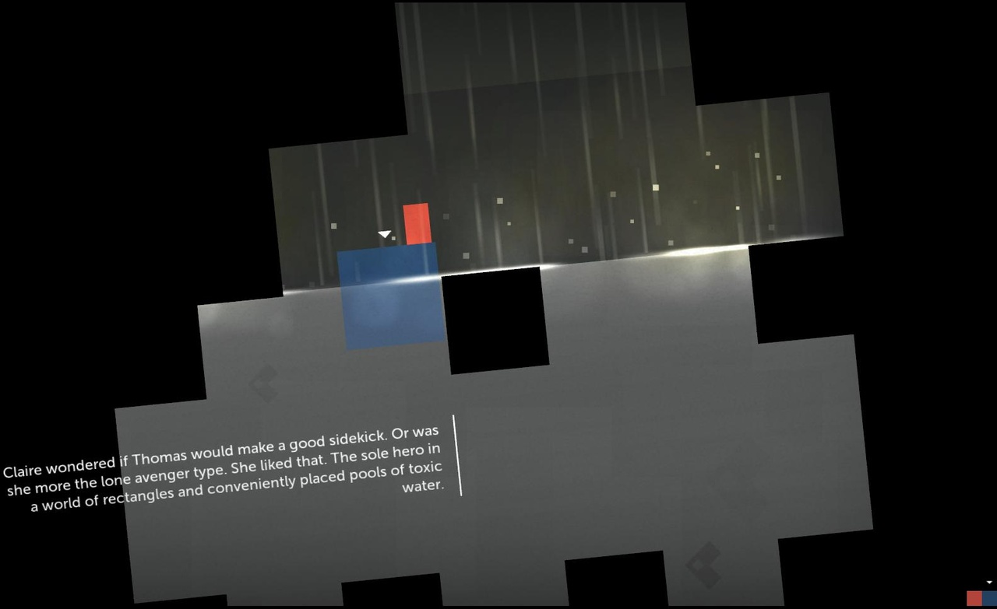
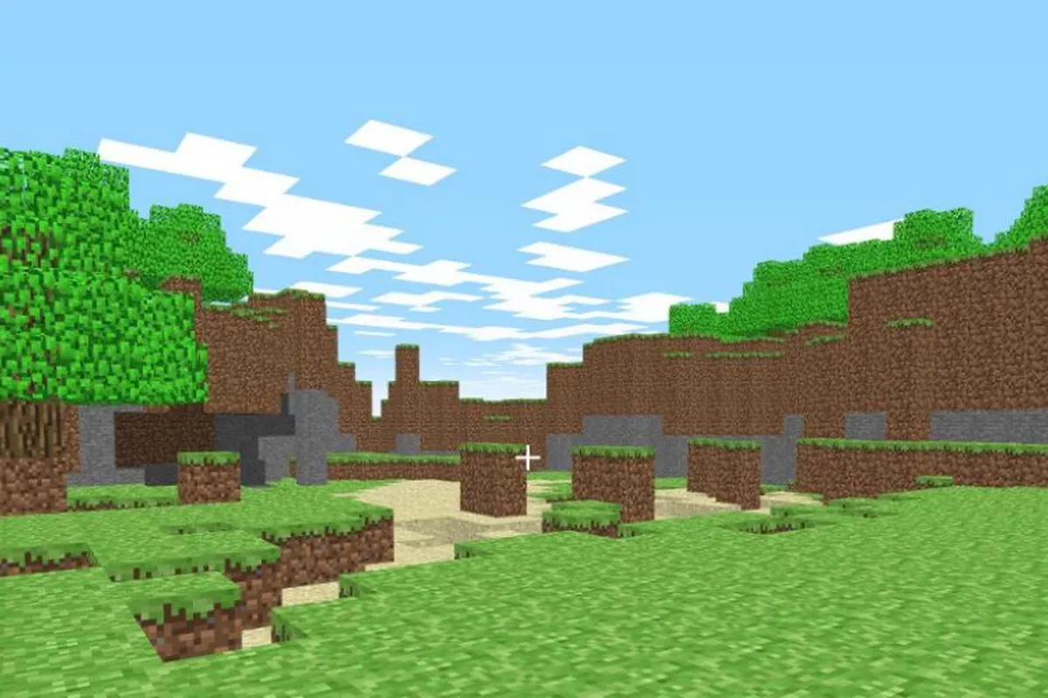
Braid; Stardew Valley; Minecraft; Thomas was Alone
Notes:
Despite their different art and music styles, these games have something in common: they were created by teams of only 1 or a few people (though minecraft now has community support). As a bonus, they are all indie games and most were developed with a low or no budget.

Slide 37
Narrative

Slide 38
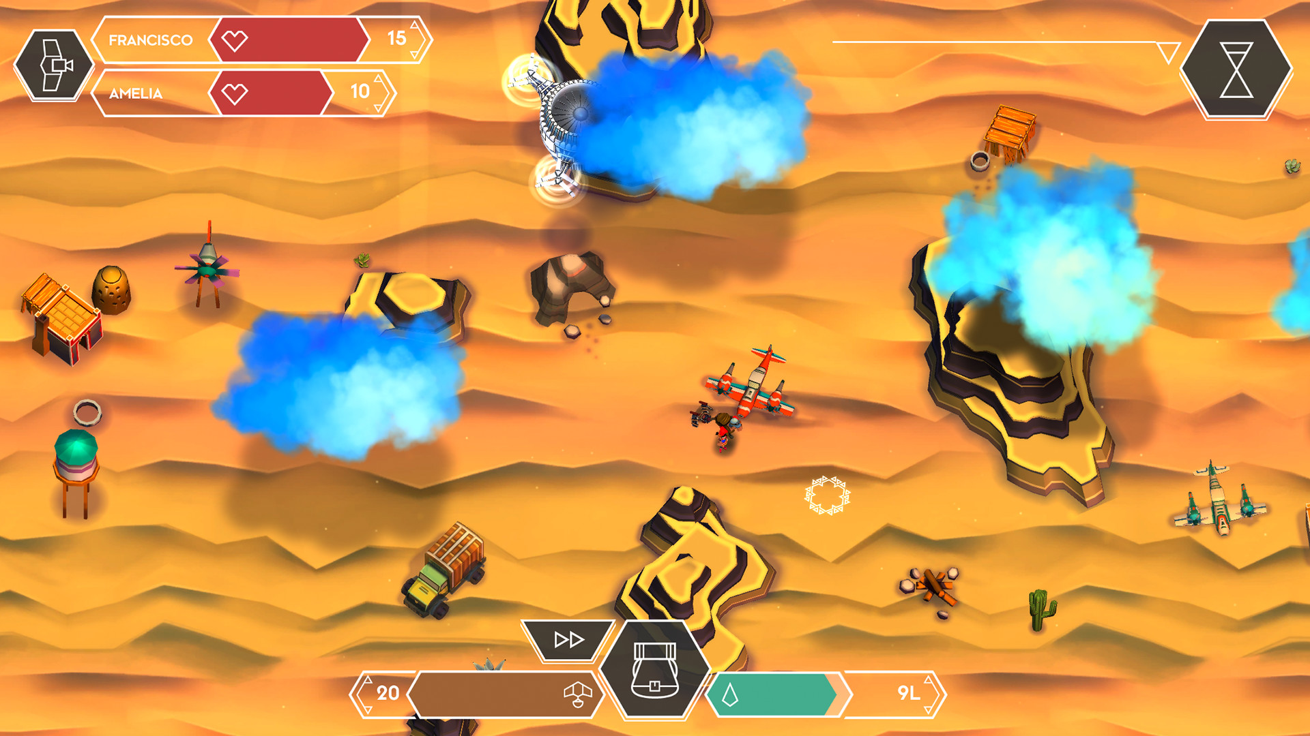
Cloud Chasers: A Journey of Hope
Notes:
Ludonarrative dissonance (gameplay is at odds with the story) was the biggest hurdle. If you’re going to create a game to garner empathy, don’t make the character a cog.

Slide 39
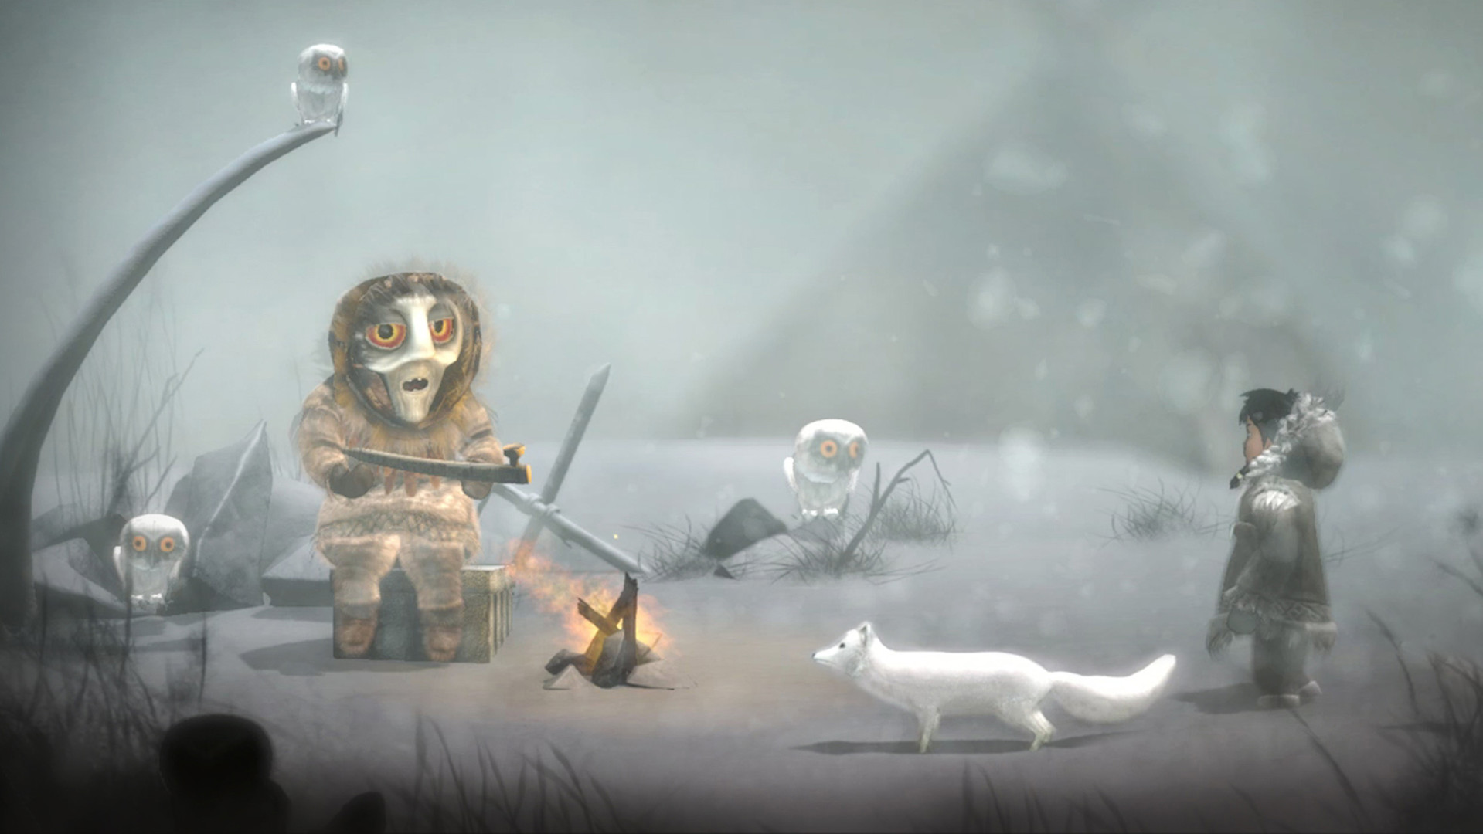
Never Alone: Kisima Ingitchuna
Notes:
Another problem that was not part of cloud chasers, but I find a lot in empathy/education games is the content being divorced from play. This game did tell a story, but tried to shoehorn other educational information in a way that was divorced from the game and it felt like there were 2 sides. A fun and a learning.

Slide 40
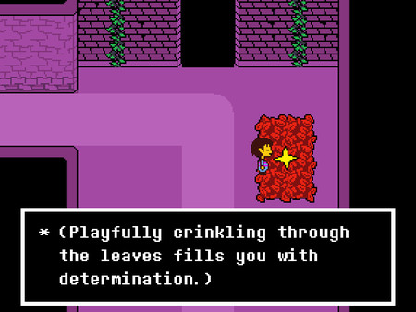
Undertale, The Sims (4)
Notes:
Linear vs non-linear. Two extremes.

Slide 41
This is not the time for a hero/villain story...
...people won’t feel empathy for a MarySue.
Notes:
This happens in propaganda games: in an effort to further your cause you distort real data and also make your characters less human.

Slide 42
Medium

Slide 44
Fun
Notes:
Fun is the most difficult category to qualify. How do you describe fun?

Slide 45
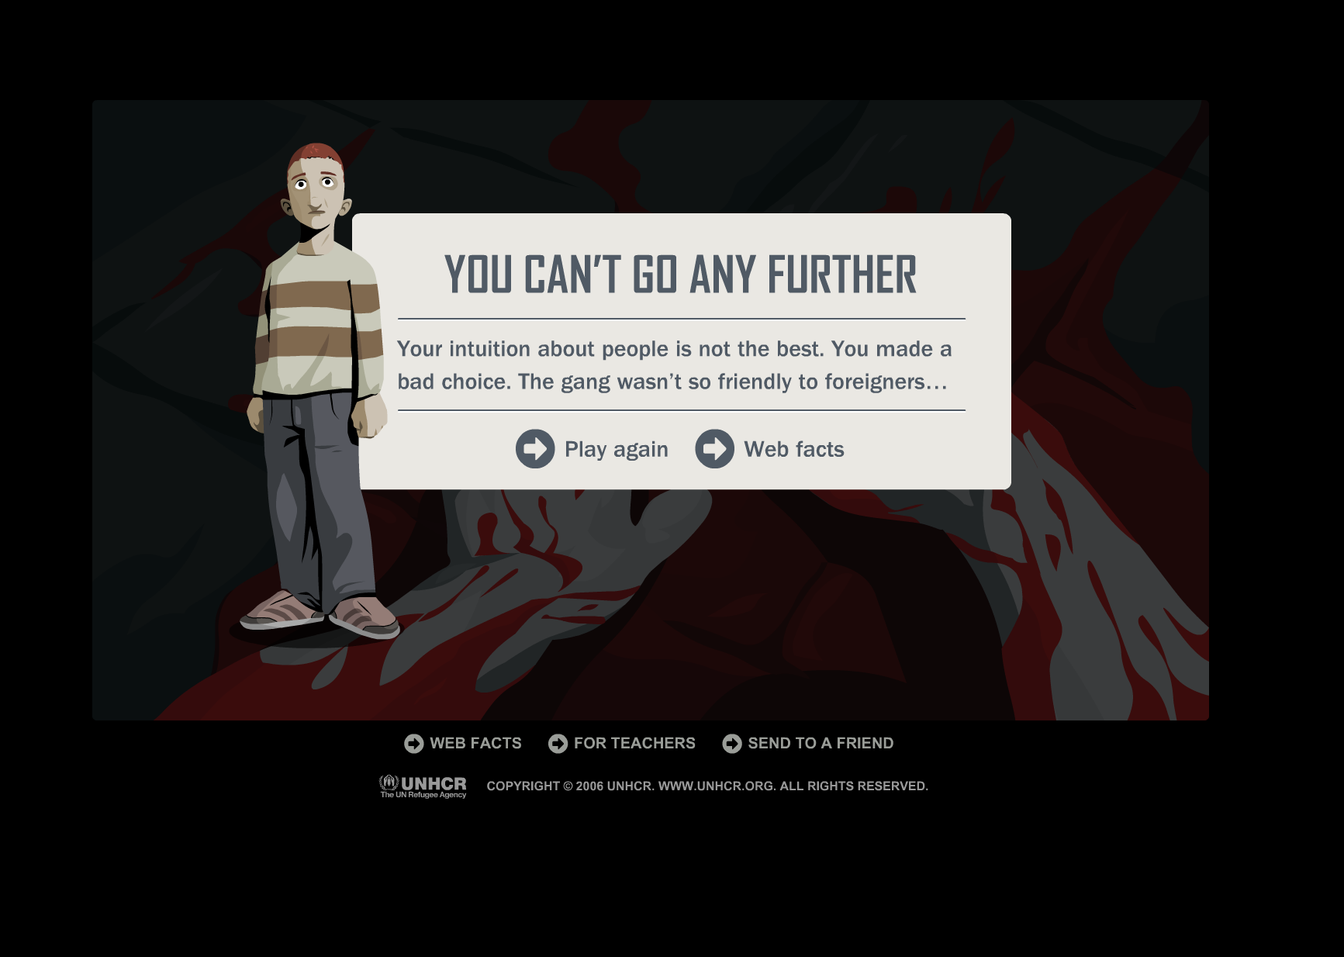
Against All Odds
Notes:
Nearly as fun as the sexual harassment/ethics training we do. Had no time to get attached to the characters. No indications what choices were right or wrong. Content was divorced from play.

Slide 46
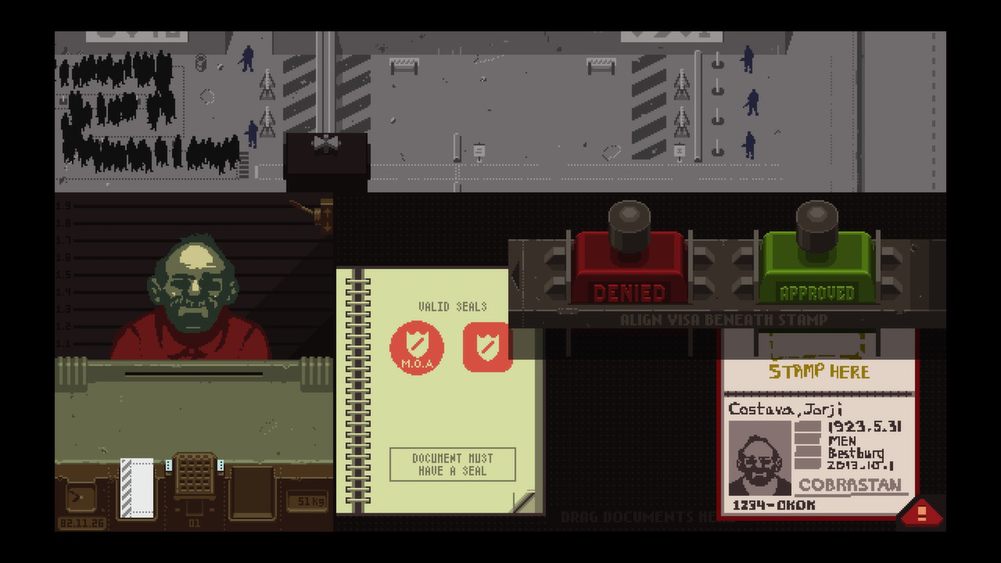
Papers, Please
Notes:
EXPLAIN PLOT
“But then other things start to happen in the middle of the monotony. A man with an incurable illness is trying to smuggle his medication. A drug smuggler offers a bribe to avoid a search. It's more than the fine if you screw up. Do you let him through? A known criminal has all the correct paperwork in place. Do you let HIM through? A pleading mother is missing her permit and begs to be reunited with her family, at the cost of a meal for your own. Soon the questions about loyalty, racism and ethics become a constant barrage and your methods and motives are forced into uncomfortable places. The world hinges on your stamp.” -Anonymous Commenter

Slide 47
Thank You
Presentation by Alexis Kim (ankim2@illinois.edu)

